Slide 1
CSE471 Lab
Project Basics

Slide 2
Front-End
The front-end of a website refers to part of the site that your user interacts with directly. Coding languages like HTML and CSS are parts of the site that encompass the front-end because they’re the languages that your user’s browser reads. If you think of your website like a restaurant, the front-end is your server, the menus and the decorations, basically anything you, the customer, can see and interact with.

Slide 3
Back-End
The back-end of a website is everything that the user can't see and interact with. Typically back-end coding languages like PHP or .NET are run on a server. For this reason, the back-end code is also sometimes referred to as server-side code. So if we're sticking with the restaurant example from above, the back-end is the kitchen and cooks. The kitchen and cooks are out of your view, but they're still there making the food and are obviously important to the functionality of the restaurant. Similarly, a functional website needs a strong back-end to interact with the front-end in order to be successful. Developers will use programming languages, such as JavaScript and SQL, to create the backend components, which can include databases, web services, APIs and more.

Slide 4
Databases
A database is a collection of structured information organized in tables, that can be accessed by users or applications through queries
Databases are used to store user data, such as accounts and passwords, product information, payment details and statistics. Your web development project will revolve around a database, such as
Relational or Row-based Database: MySql (Tool: phpMyAdmin), Postgre (Tool: Prisma Studio), Oracle , Microsoft SQL Server
Document-oriented Databases: MongoDB (Tool: Compass, Atlas [Cloud database], Prisma)

Slide 5
What is a Framework?
A framework provides a foundation that developers can use to build programs and streamline the development process. They help you add extra functionality to your site without having to start from scratch or create a simple feature that could take you hours to write.

Slide 6





Backend
Spring boot (Java)
Asp.Net Core (C#)
Django (Python)
Express.js (Javascript)
Nest.js (Javascript)
Laravel (PHP)

Slide 7



Frontend
HTML
CSS
Angular
React
Vue.Js

Slide 8
Web Request and Response
(How Front-end and Back-end communicate)
A web request is a request made by a client, such as a web browser, to a server in order to retrieve a web page or other resource. Web requests are sent using the Hypertext Transfer Protocol (HTTP), which is a standard protocol for transmitting data on the World Wide Web.
GET is used to request data from a specified resource.
An HTTP response is made by a server to a client. The aim of the response is to provide the client with the resource it requested, or inform the client that the action it requested has been carried out; or else to inform the client that an error occurred in processing its request.
POST is used to send data to a server to create/update a resource.

Slide 9
API
API stands for “Application Program Interface.” This is how computers and applications can communicate with one another.
By allowing two applications to talk to one another, APIs help developers quickly retrieve data, alter content and interact between databases

Slide 10
REST API
A REST API is an application programming interface (API) that follows the design principles of the REST architectural style. REST is short for representational state transfer, and is a set of rules and guidelines about how you should build a web API.

Slide 11
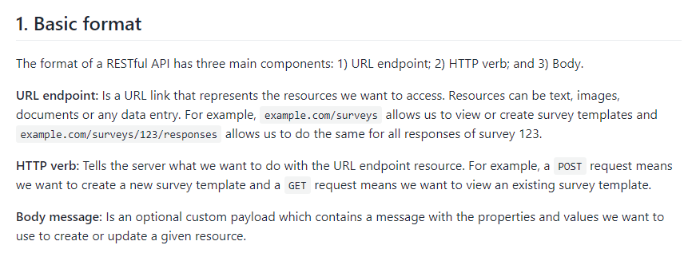

Slide 12
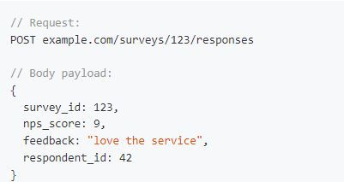

Slide 13
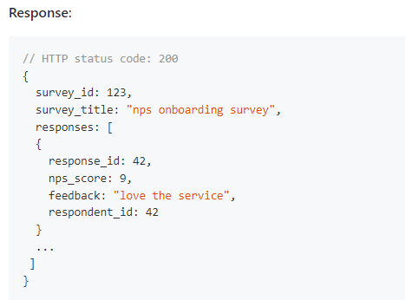

Slide 14
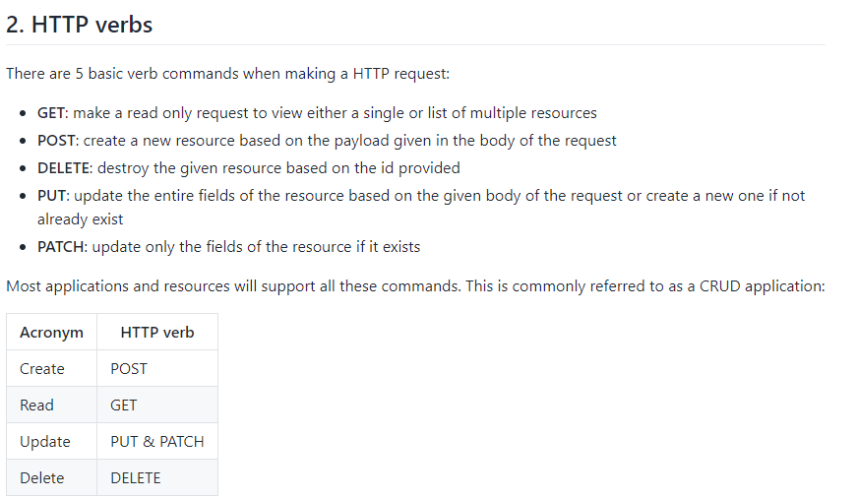

Slide 15
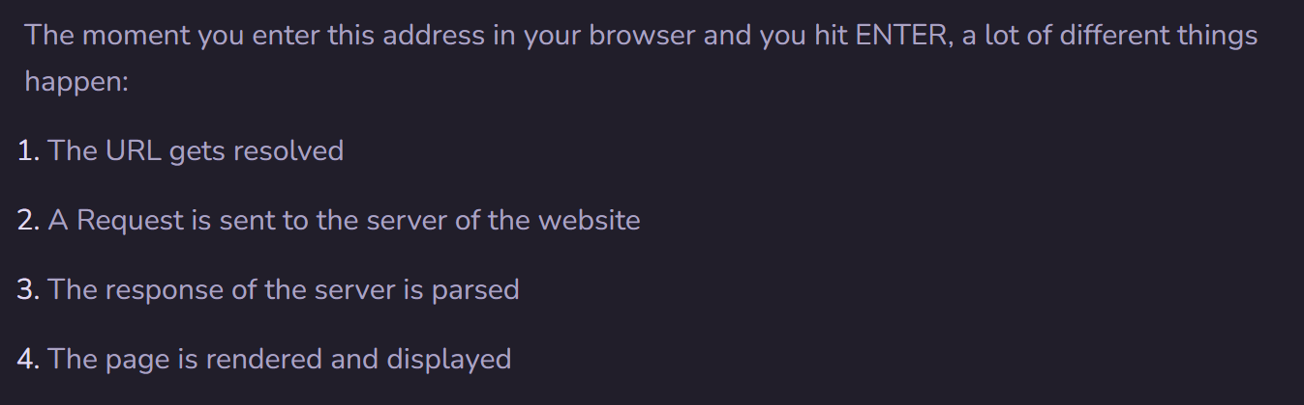
Website Working process in Steps

Slide 16
MVC vs Non MVC
Separation of Concern:
Non-MVC: if we change a part in front-end, the impact will be visible on both front-end and back-end. Maintenance is difficult.
MVC: As Front-end and Back-end are separated, we can easily change the code of a particular part. So maintenance is easy, less resources are used.

Slide 17
Cache
Cache is temporary data storage that helps site speed by storing relevant information on your computer the first time you visit a website. Thanks to cache, when you visit the website again, your computer does not have to reload all the website information as its already saved.

Slide 18
Cookies
This is data saved by your web browser on to your computer. It identifies you -- from how often you visit a site, to what parts you visit the most, even your preferences when browsing and more.

Slide 19
User Interface (UI)
The user interface is simply how a user interacts with the design on a page. For example, the battery indicator on your smart phone is a part of the user interface. Sometimes UI is lumped with UX, which includes how pretty the site is, the site's response time, and site content.

Slide 20
User Experience (UX or UXD)
User Experience, or User Experience Design, as it's sometimes called, focuses on the human interaction with the computer or device. For example, the action that happens if you were to tap the battery indicator on your phone is a part of the user experience. So while the UI is the design of something that your users will interact with, the UX is what will happen when the interaction actually takes place.

Slide 21
Plug-in
Plugins are software components added to provide extra functionalities to a website, which can enhance both UX and UI. Used by both designers and developers, they create the possibility of customizing a website without the need for uniquely written code. For example, if you wanted to watch a video on a website, you may need a plugin to do so. If the plugin is not installed, your browser will not understand how to play the video.
Some examples of popular plugins include:
WooCommerce: Allows websites to act as eCommerce stores, featuring countless customizations to support online sales processes.
WPForms: Supports the implementation of pre-made contact forms into a website by a drag-and-drop function.
Yoast SEO: Helps website owners manage their SEO optimization through numerical insights and written best practices.

Slide 22
Git
Git is a version control system that allows developers to keep track of their codebase, monitor changes and collaborate on projects with other developers.
If you’re working on your own web development project, Git can provide useful source code change history to streamline the process of identifying bugs and making necessary fixes.

Slide 23
GitHub
GitHub is a cloud-based version control platform that provides developers with a secure and collaborative environment to store their codebase, track changes, and partner on projects with other developers.
Github Student Pack: https://education.github.com/pack

Slide 24
References
https://www.pluralsight.com/blog/creative-professional/key-web-design-terms-need-know
https://www.digitalsilk.com/digital-trends/web-development-terms/
https://www.impactplus.com/blog/42-web-development-terms-everyone-should-know

